Slide 1
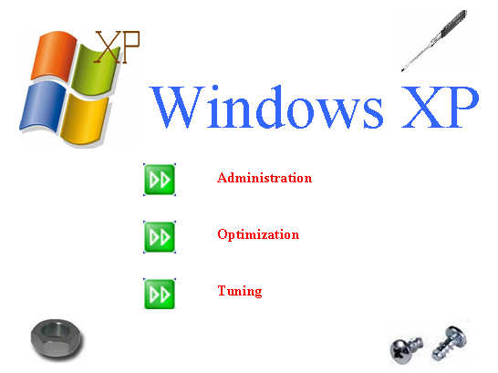

Slide 2
Problem Definition
For a layman, it is not easy to perform various tasks such as restricting access to several key Windows XP applications, registry backup, tweaking Windows features like dealing with the start menu, desktop and internet explorer, running manual scandisk of desired local drives.
Even for the skilled computer professional, it can be a tedious job to perform the mentioned tasks.
Furthermore, it is not possible to carry out the required tasks via a single application. It requires the user to switch between several applications, including modifying registry values, which can prove to be quite hazardous for the computer in case some crucial registry values are accidentally modified or deleted.

Slide 3
Problem Definition
An efficient and user friendly application is greatly required to help the user perform the above mentioned tasks and modify registry values without worrying about the risk of corrupting essential files.
Also, it would be very helpful to the user if the tasks could be performed with the help of just one application.

Slide 4
Abstract
Microsoft Windows XP operating system has undisputedly been the best operating system till date with respect to it’s number of users worldwide, low system requirements, easy interface etc. But as the users began to grow old and sophisticated on the Windows XP platform they seem to require additional features and utilities apart from those provided by default from the OS.
W.A.O.T. is a tool for Windows operating system users who wish to tweak the PC system to the optimal performance, tweaking the features to their own discretion and performing additional operations which otherwise may be hidden or impossible.
It includes creating a virtual drive pointing to a location on disk.

Slide 5
Abstract
The program enables you to manage registry modification, optimize system and administer Windows XP using various other utilities like screen locking, screen capturing etc.
There are a variety of tools available over the Internet like Registry Mechanic, Toolkit Utilities 2008, Advanced PC tweaker, Network Admin Elite, etc which provide the same features to the user. W.A.O.T. acts as a superset of all of the above applications by providing all of the features bundled together with a precise and a lucid interface.

Slide 6
Targeted Users
Users that are not well versed with the nitty-gritty's involved in performance and hidden functions of Windows .
Cyber Café Administrators.
Computer professionals working with frequent registry changes.
Network Administrators.

Slide 7
Project Features

Slide 8
1] Administration
Screen Capturing.
Screen Locking.
Time based Shutdown/Restart/Log Off with an alert.
User authentication for security reasons in W.A.O.T. application.

Slide 9
2] Optimization
Tweaking Windows features through Windows Registry Editor v5.1
The above motive can be achieved over the following:
  Windows Explorer
  Start-Menu
  Control Panel
  Desktop

Slide 10
3] Tuning
Manual Scan – disk of local drives with additional features of:
  Performing scan disk as and when required, and not just in case of irregular shut down.
  Dismounting the drives
  Fixing the errors.
  Generating a status report
  Recovering lost file-fragments.
Restricting access to several key Windows XP applications.
Creating a virtual drive which points to a location on the disk.

Slide 11

System Requirements
Hardware:
    Intel Pentium II(400 GHz) or
    AMD Duron 1000+ or equivalent
    128 MB RAM
    100 MB HDD space
    VGA driver that supports a resolution of 800 x 600 pixels.
Software:
  Microsoft Windows XP [Home/Professional]
  JDK 1.6 Update 6
  MS-Access

Slide 12
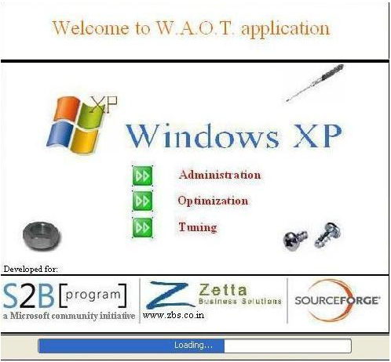
User Interface

Slide 13
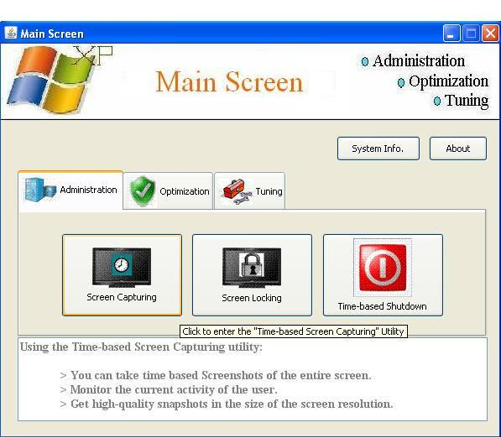
User Interface

Slide 14
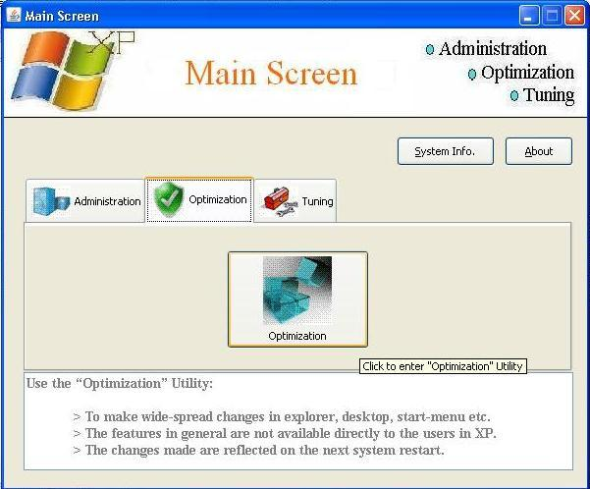
User Interface

Slide 15
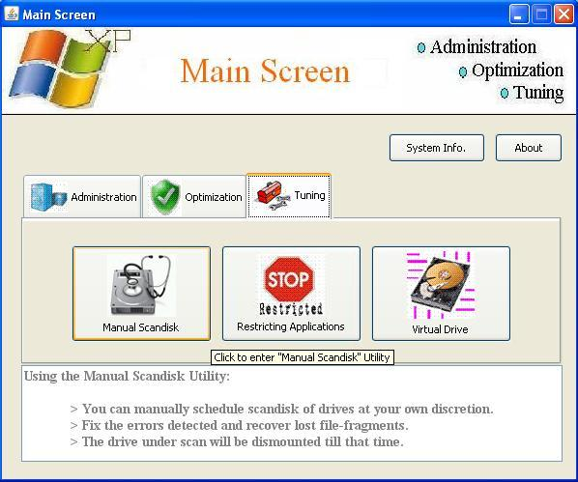
User Interface

Slide 16
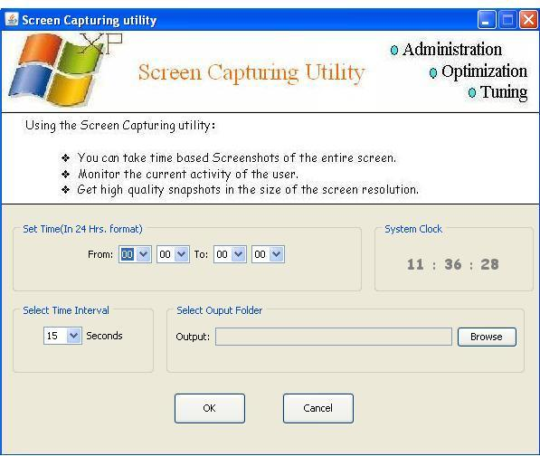
User Interface

Slide 17
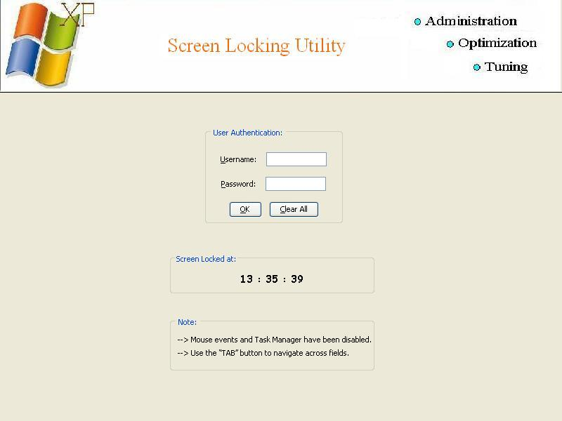
User Interface

Slide 18
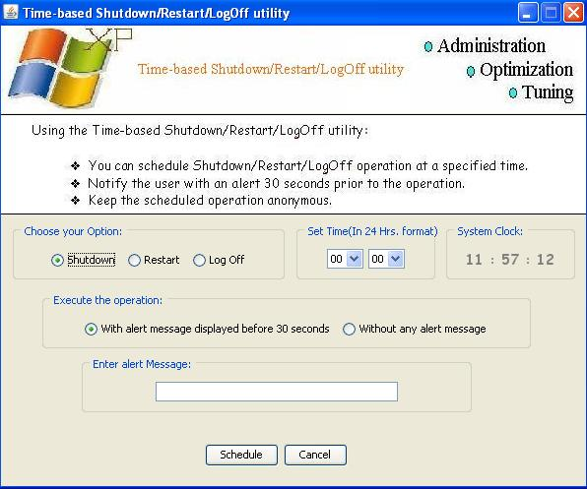
User Interface

Slide 19
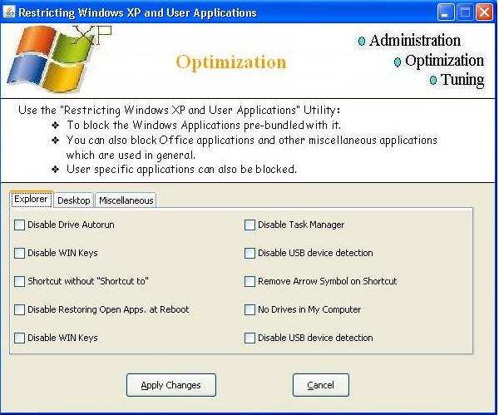
User Interface

Slide 20
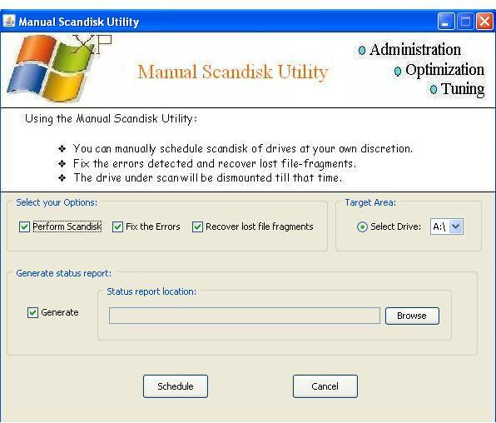
User Interface

Slide 21
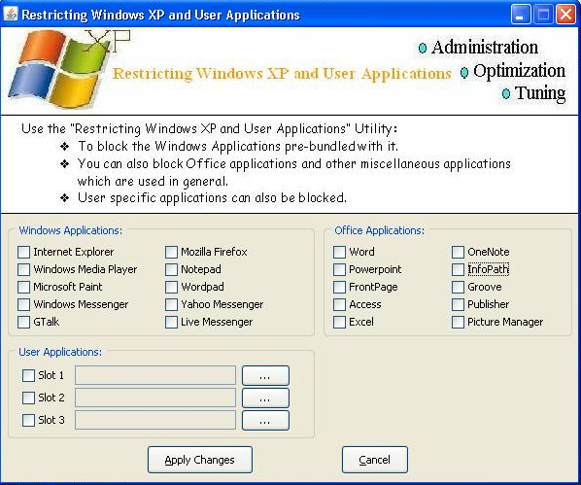
User Interface

Slide 22
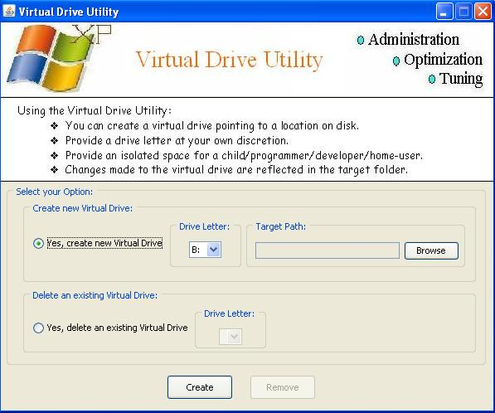
User Interface

Slide 23
Tools and Technologies

Slide 24
JAVA
Java refers to a number of computer software products and specifications from Sun Microsystems that together provide a system for developing application software and deploying it in a cross-platform environment. Java is used in a wide variety of computing platforms spanning from embedded devices and mobile phones on the low end to enterprise servers and supercomputers on the high end. Java is nearly ubiquitous in mobile phones, Web servers and enterprise applications, and while less common on desktop computers, Java applets are often used to provide improved functionality while browsing the World Wide Web.

Slide 25
MS-Access
Microsoft Office Access, previously known as Microsoft Access, is a relational database management system from Microsoft that combines the relational Microsoft Jet Database Engine with a graphical user interface and software development tools. It is a member of the 2007 Microsoft Office system.

Slide 26
Windows Registry Editor
The Windows registry is a directory which stores settings and options for the operating system for Microsoft Windows 32-bit versions, 64-bit versions, and Windows Mobile. It contains information and settings for all the hardware, operating system software, most non-operating system software, users, preferences of the PC, etc. Whenever a user makes changes to Control Panel settings, file associations, system policies, or most installed software, the changes are reflected and stored in the registry. The registry also provides a window into the operation of the kernel, exposing runtime information such as performance counters and currently active hardware. This use of registry mechanism is conceptually similar to the way that Sysfs and procfs expose runtime information through the file system (traditionally viewed as a place for permanent storage), though the information made available by each of them differs tremendously.

Slide 27
Limitations
  Windows Administration, Optimizing and Tuning (W.A.O.T.) is only compatible with computers using the Windows XP operation system.
  Furthermore, W.A.O.T. assumes that the indented user using the application is an Administrator with administrative privileges. If the user lacks the sufficient privileges then the application might be rendered handicapped or completely futile.

Slide 28
Future Scope
  The current version of Windows Administration, Optimizing and Tuning (W.A.O.T.) is being planned and designed only for the Windows XP operating system. Future versions can also be designed to operate on upcoming operating systems of Windows such as Windows Vista.
  Also, they can incorporate new modules to modify a greater number of registry values.
  Since one of W.A.O.T.’s functions is to deal with registry values and their modifications, it can also be used as an efficient anti-virus package since the primary attack of a virus is the registry.

Slide 29
Bibliography
Books:
Tata McGraw Hill – Java 2 The Complete Reference (J2CR)
Ethical Hacking using Batch File Programming – Ankit Fadia
Ethical Hacking using Windows Registry Editor – Ankit Fadia
Websites:
http://www.wikipedia.org
http://www.advancedpctweaker.com
http://www.google.com
http://www.tweaknow.com

